Slide 1




RSE
SunScope
Maximize Solar Savings, One at a time

Slide 2
Team Cyphers
Team Leader : Aditya Pratap Singh
Team Member 1 : Srijan Sarkar
Team Member 2 : Nilesh Kanti
Team Member 3 : Shantam Ranjan
Team Member 4 : Rishit Vats

Slide 3
Introduction :
Many people are unaware of how much solar energy their rooftops can generate and the potential savings from solar panels. To address this, we propose a web platform that uses machine learning to calculate solar energy potential. Users can upload satellite images of their rooftops, and our platform will use Convolutional Neural Networks (CNN) to identify building footprints and calculate areas using GeoPandas and Rasterio. By incorporating solar irradiance data, we can estimate potential energy generation and provide a financial analysis of the savings from solar panel installations. Hosted on cloud platforms like AWS, Microsoft Azure, or Google Cloud, our solution helps users understand their solar potential and encourages sustainable energy practices.

Slide 4
Problem Statement :
.
In today's push for sustainable development, households often struggle with high electricity bills, especially during the summer, due to the lack of solar energy adoption. Despite the availability of advanced technologies, we are not fully utilizing solar panels to tap into renewable energy sources. By embracing solar energy, we can significantly cut down on electricity expenses and make a positive impact on the environment. This shift not only offers financial benefits but also supports global efforts toward sustainability by relying on clean, renewable energy. Investing in solar solutions can help reduce our carbon footprint and create a more eco-friendly future.

Slide 5
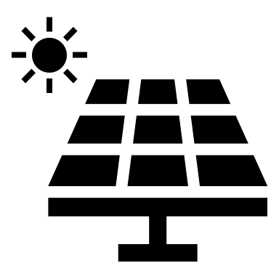
Approach and Solution
First we will get the aerial satellite imagery from spacenet for a particular
area and do building footprint extraction using CNN.
Since the solar energy generated on rooftops is directly proportional
to the area of the rooftop, we need to calculate the area of the rooftop
using geopandas and rasterio.
Then we will get the solar radiation dataset from National Solar Radiation Database(NSRDB) to get the amount of solar energy received per unit per day in that area.
After that we will do Image Processing to enhance the quality of satellite images to make the building footprints clearer.
Then we have to estimate the solar energy potential, we have to combine the rooftop area calculated with the solar irradiance data.
Estimating solar energy potential

Slide 6
After that we will use Geographic Information Systems(GIS) to create a map that visually represents the solar energy potential.
Then we will validate and evaluate our GIS map’s accuracy with on-site inspections and real-world data
We will create a website for this problem statement where the user will upload the satellite image of their rooftop from google maps
According to the rooftop we will tell the user the rooftop area and how much solar potential energy can be generated from the rooftop.
We will also tell the user how much amount of money he can save if he installs solar panel on his rooftop solar energy that can be generated using his rooftop.
To deploy our website, we will utilize AWS/Microsoft Azure/Google Cloud platform to ensure robust security, extensive reach, and continuous monitoring.

Slide 7
Tools and Technology used
Languages: Python, HTML, Javascript, CSS, PostgreSQL, Leafletjs
Frameworks/Libraries: scikit-learn, Tensorflow, OpenCV, Pandas, Matplotlib, Seaborn, Numpy, GeoPandas, Rasterio, Pytorch, React-native, Flask.
Cloud Services: AWS/MsAzure/Google Cloud Platform

Slide 8
Uniqueness of our Solution
Our idea fills a gap in public awareness about solar energy's value.
The current process of installing solar panels is cumbersome and time-consuming
Individuals need to contact the electricity department.
They must wait for an inspection and receive an estimate of solar potential.
This complexity often discourages people from considering solar energy.
Our website simplifies this process significantly.
Users can upload a picture of their rooftop from Google Maps or other sources.
They receive a quick estimate which saves time and money.
It makes adopting solar energy mate of their rooftop's solar energy potential.
This approach solutions easier for people.

Slide 9
USP of the Proposed Solution
Cost Savings Calculation: Provide users with estimates of potential cost savings from installing solar panels,
offering a clear financial incentive.
Geographic Information Systems (GIS) Mapping: Create GIS maps to visually represent solar energy potential,
providing an intuitive and user-friendly interface for understanding solar capabilities.
User-Friendly Website Interface: Develop a website where users can upload satellite images of their rooftops from
Google Maps, and receive detailed information about rooftop area, solar potential, and potential cost savings.
Validation with Real-World Data: Validate and evaluate the GIS map’s accuracy with on-site inspections
and real-world data, ensuring reliability and precision.

Slide 10
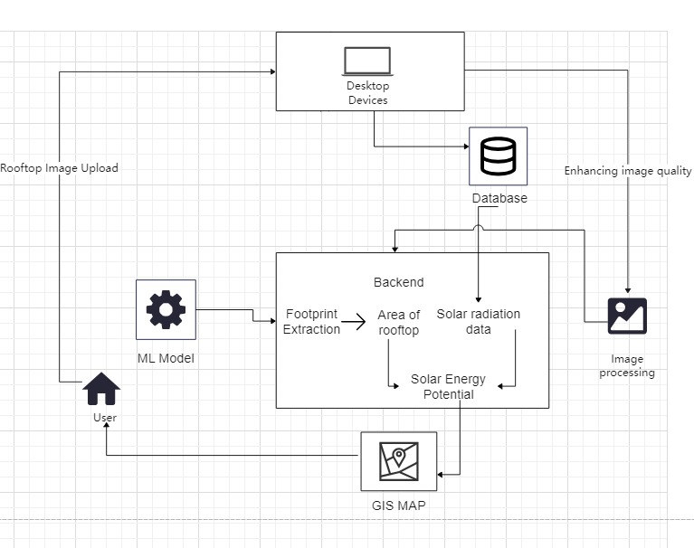
Architechture Diagram

Slide 11
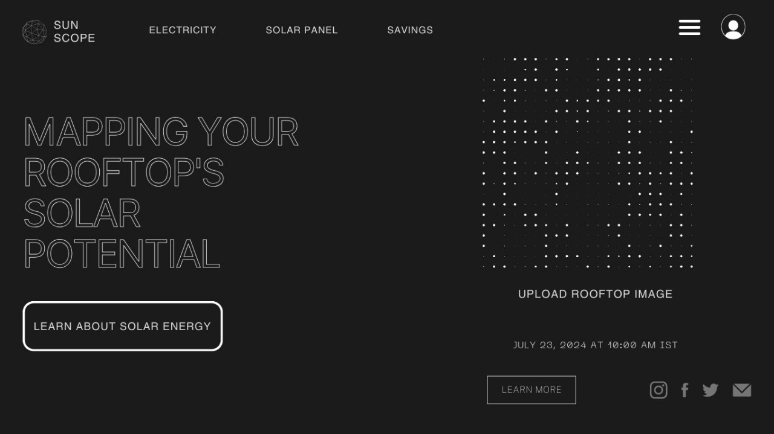
Quick Glance at our Website

Slide 12
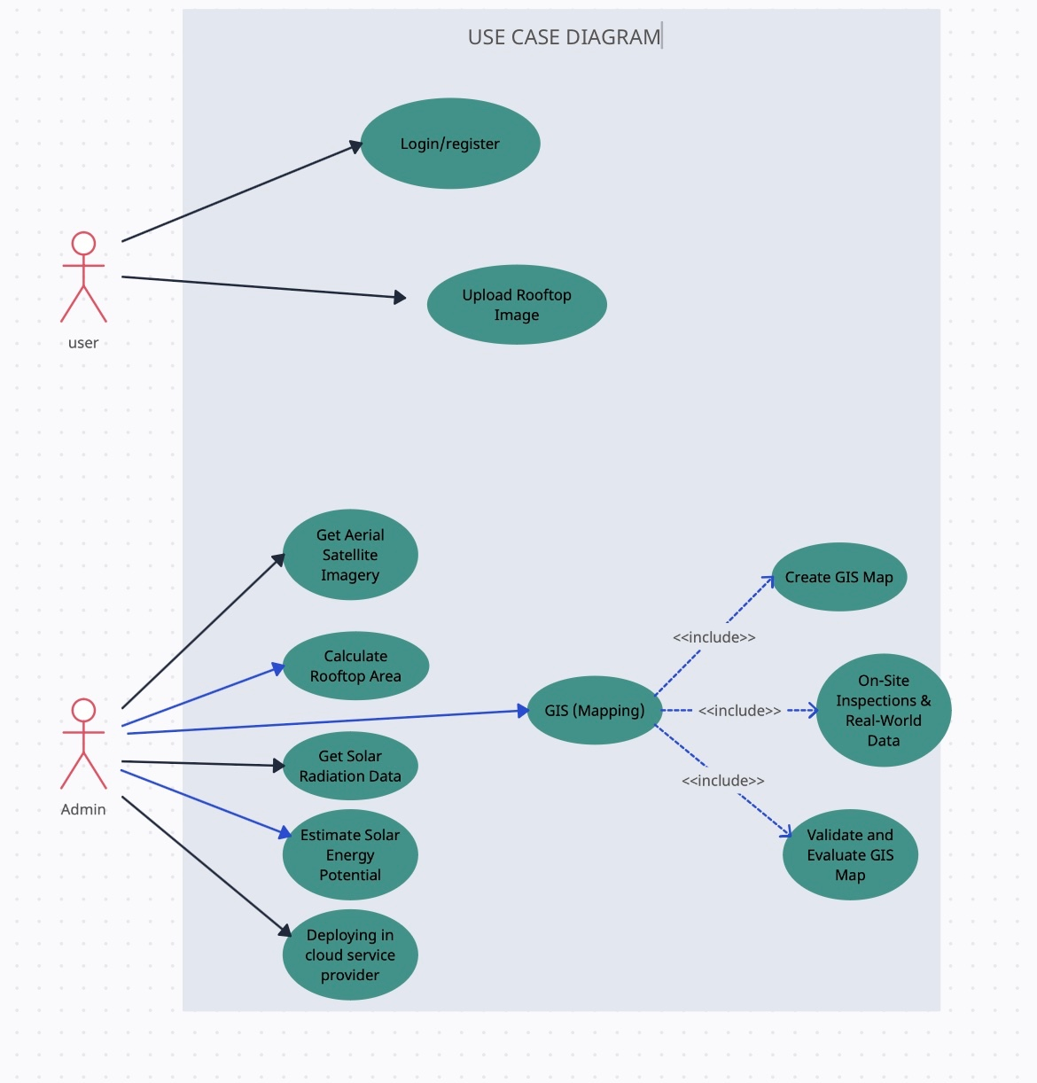
Use Case Diagram

Slide 13
Feasibility
1)A solar panel's efficiency depends on how much sunlight it receives throughout the day. A site's slope and orientation can affect how well it's exposed to sunlight.
2)A site inspection can help determine if a location is suitable for solar panels. This includes evaluating the site's topography, roof suitability, and shading patterns.
3)This involves understanding historical energy usage and identifying peak demand periods.
4)The identification and evaluation of potential risks and challenges, such as weather-related impacts and market fluctuations is neccessary
Scalibility
A scalable solar installation can adapt to changing energy needs as a business grows or expands. A solar-wind hybrid can help provide a smoother energy output in places that don't have consistent wind when the sun shines.

Slide 14
Impact
Impact is that our model will help save renewable energy and as we use solar power the electricity cost will also reduce by upto 90%
Solar panels are non-polluting, which helps improve air quality
Solar energy can help promote energy independence, which can be especially beneficial for remote areas without access to other sources of electricity.
Technical Approach
In the technical approach we will be using a machine learning model which will detect the are of the roof with the help of stelite image of google maps , we will make a thermal map which will tell us that at which location how much heat is generated and how many solar panels can be fitted in the specific area and it will also tell about the energy generated .The tools which we will use for this project are Python, HTML, Javascript, CSS, PostgreSQL, Leafletjs and machine learning

Slide 15
Target Audience
Target audience are the societies and companies which need to reduce their electricity costs.
Large offices should start using solar panel so that electricity consumption is less which is beneficial for nature and for every individual

